Slide 1
WEBMONK (COURSE DAY - 10)
Topics covered:
* what is database & its types?
* SQL vs NOSQL
* More on NOSQL
* MongoDB basics
* brief discussion - sharding, master-slave, backup, ACID

Slide 2
DATABASE & ITS TYPES

Slide 3
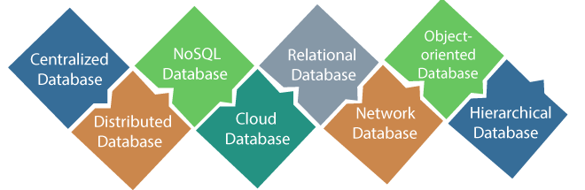
DATABASE & ITS TYPES
a database is an organized collection of structured information, or data, typically stored electronically in a computer system. A database is usually controlled by a database management system (DBMS). Together, the data and the DBMS, along with the applications that are associated with them, are referred to as a database system, often shortened to just database.

Slide 4
SQL VS NOSQL

Slide 5
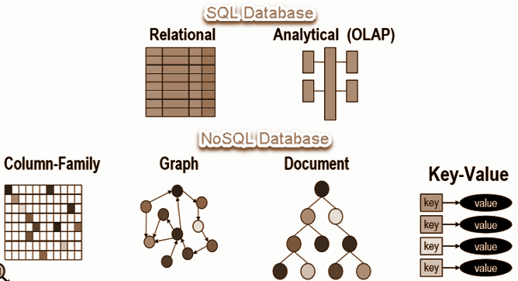
SQL VS NOSQL
* SQL databases are relational, NoSQL are non-relational.
* SQL databases use structured query language and have a predefined schema. NoSQL databases have dynamic schemas for unstructured data.
* SQL databases are vertically scalable, NoSQL databases are horizontally scalable.
* SQL databases are table based, while NoSQL databases are document, key-value, graph or wide-column stores.
* SQL databases are better for multi-row transactions, NoSQL are better for unstructured data like documents or JSON.

Slide 6
MORE ON NOSQL

Slide 7
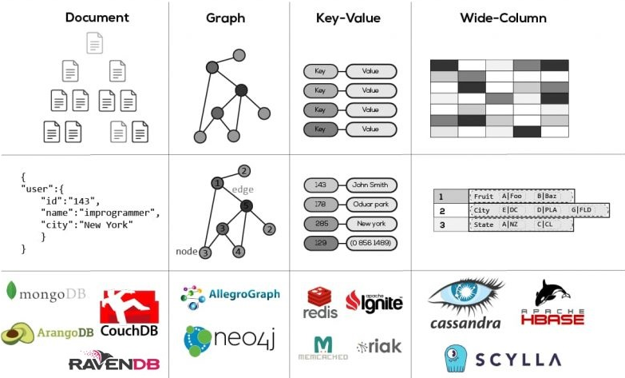
MORE ON NOSQL
* NoSQL databases (aka "not only SQL") are non tabular, and store data differently than relational tables. NoSQL databases come in a variety of types based on their data model. They provide flexible schemas and scale easily with large amounts of data and high user loads.
* NoSQL data models allow related data to be nested within a single data structure.
* NoSQL databases emerged in the late 2000s as the cost of storage dramatically decreased. Gone were the days of needing to create a complex, difficult-to-manage data model simply for the purposes of reducing data duplication. Developers (rather than storage) were becoming the primary cost of software development, so NoSQL databases optimized for developer productivity.

Slide 8
MONGODB BASICS

Slide 9
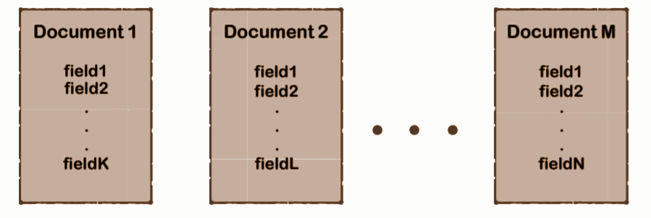
WHAT IS MONGODB?
* MongoDB is a cross-platform document-oriented database program.
* Classified as a NoSQL database program, MongoDB uses JSON-like documents with optional schemas.

Slide 10
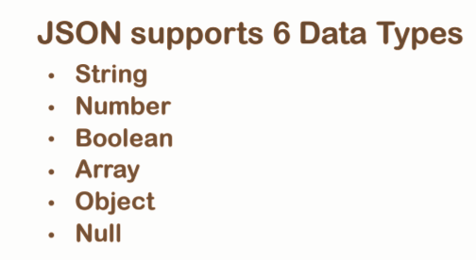
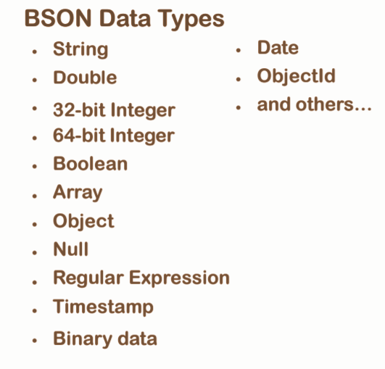
JSON VS BSON
* JSON a.k.a JavaScript Object Notation is an open standard file format, and data interchange format, that uses human-readable text to store and transmit data objects consisting of attribute–value pairs and array data types.
* BSON is a computer data interchange format. The name "BSON" is based on the term JSON and stands for "Binary JSON". It is a binary form for representing simple or complex data structures including associative arrays, integer indexed arrays, and a suite of fundamental scalar types. BSON originated in 2009 at MongoDB.

Slide 11
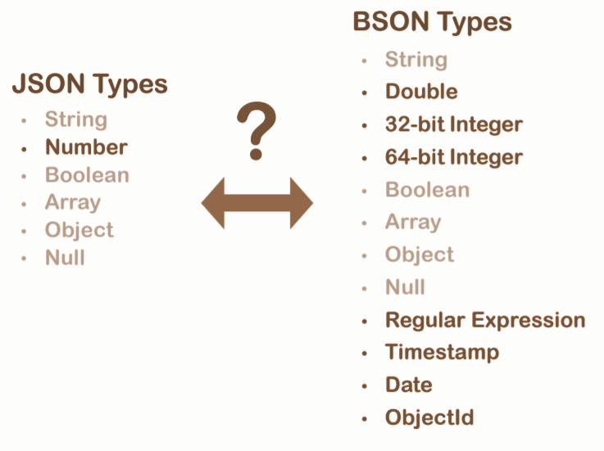
CONVERSION

Slide 12
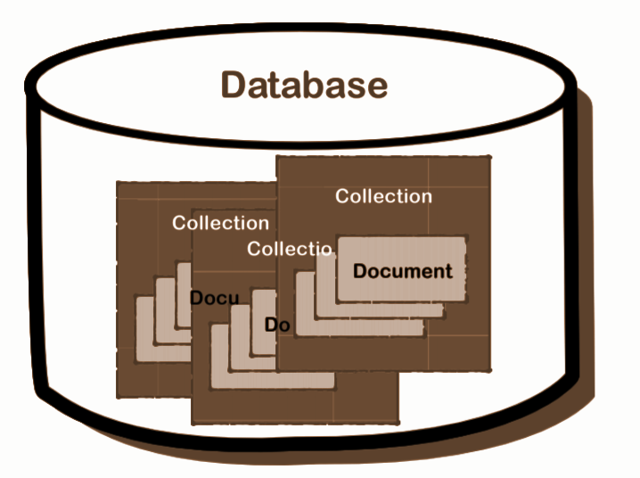
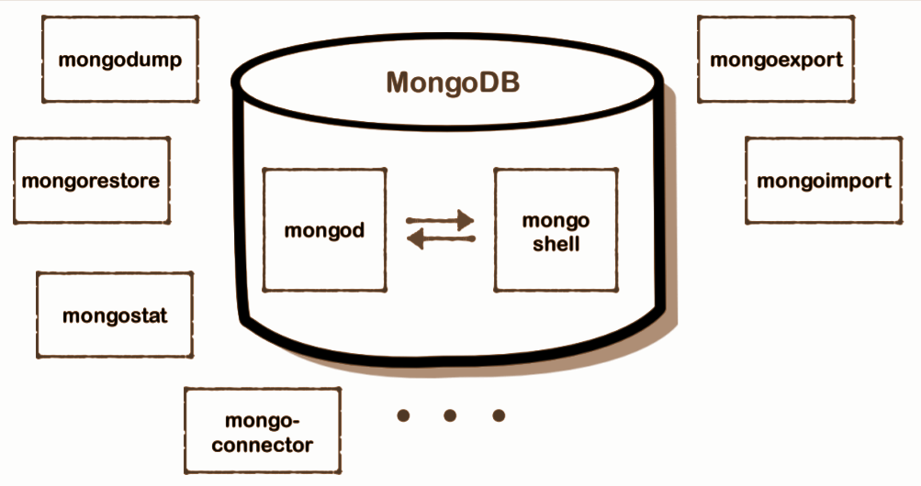
MONGO STRUCTURE & ARCHITECTURE

Slide 13
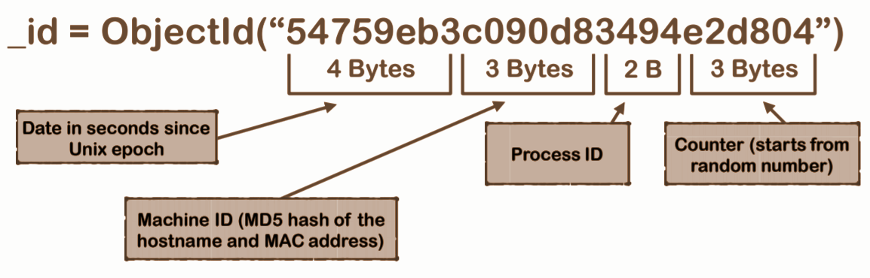
WHAT IS _id?
* Mandatory document field.
* Can be assigned manually.
* Will be created automatically if not assigned manually (recommended)

Slide 14
SOME CRUD WITH MONGODB**

Slide 15
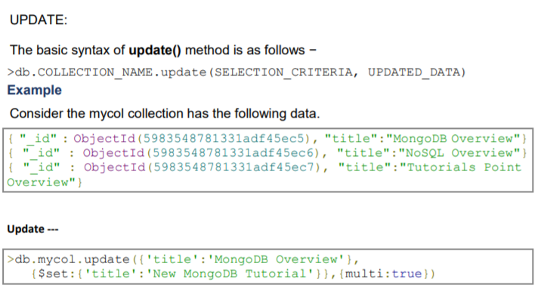
UPDATE

Slide 16
SKIP & LIMIT
The Limit() Method
To limit the records in MongoDB, you need to use limit() method. The method accepts one number type argument, which is the number of documents that you want to be displayed.
The basic syntax of limit() method is as follows −
> db.COLLECTION_NAME.find().limit(NUMBER)
> db.mycol.find({},{"title":1,_id:0}).limit(2)
If you don't specify the number argument in limit() method then it will display all documents from the collection.
MongoDB Skip() Method
Apart from limit() method, there is one more method skip() which also accepts number type argument and is used to skip the number of documents.
The basic syntax of skip() method is as follows −
>db.COLLECTION_NAME.find().limit(NUMBER).skip(NUMBER)
>db.mycol.find({},{"title":1,_id:0}).limit(1).skip(1)

Slide 17
SHARDING, MASTER-SLAVE, BACKUP, ACID

Slide 18
SHARDING
* Sharding is the process of storing data records across multiple machines and it is MongoDB's approach to meeting the demands of data growth. As the size of the data increases, a single machine may not be sufficient to store the data nor provide an acceptable read and write throughput. Sharding solves the problem with horizontal scaling. With sharding, you add more machines to support data growth and the demands of read and write operations.
* Why Sharding?
* In replication, all writes go to master node
* Latency sensitive queries still go to master
* Single replica set has limitation of 12 nodes
* Memory can't be large enough when active dataset is big
* Local disk is not big enough
* Vertical scaling is too expensive

Slide 19
MASTER-SLAVE
One database server (the “master”) is in charge and can do anything. A bunch of other database servers keep copies of all the data that’s been written to the master and can optionally be queried (these are the “slaves”). Slaves cannot be written to directly, they are just copies of the master database. Setting up a master and slaves allows you to scale reads nicely because you can just keep adding slaves to increase your read capacity. Slaves also make great backup machines. If your master explodes, you’ll have a copy of your data safe and sound on the slave.

Slide 20
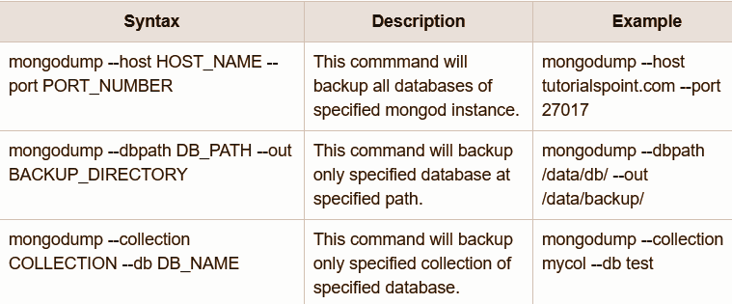
BACKUP IN MONGODB
Dump MongoDB Data
To create backup of database in MongoDB, you should use mongodump command. This command will dump the entire data of your server into the dump directory. There are many options available by which you can limit the amount of data or create backup of your remote server.

Slide 21

BACKUP IN MONGODB
Restore data
To restore backup data MongoDB mongorestore command is used. This command restores all of the data from the backup directory.

Slide 22
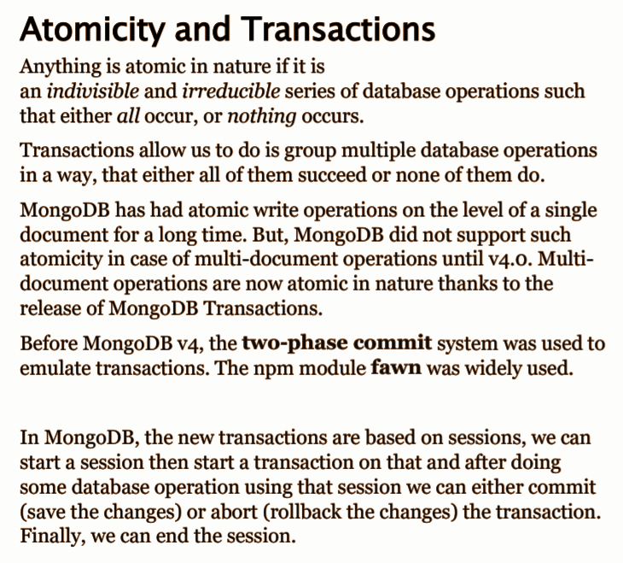
ACID PROPERTIES
Properties:
1. When all operations in a transaction are successful, the session is committed and all changes made using that session is persisted in the database.
2. When an operation using the transaction session fails, the transaction session is aborted and no intermediate changes are persisted in the database.
3. Until a transaction session is committed no write operations in the transactions are visible outside the session.

